Slide 1


Apollo
Apollo
MUSIC ON DEMAND, ANYTIME, ANYWHERE
01/26

Slide 2


Apollo
Created By
Ayush Anand
101918060
Nishtha Wakankar
101918061
Neelaksh Tayal
101918069
Akshat Bhatia
101918076
Under the Guidance of
Dr. Manju Khurana
Back
02/26
Next

Slide 3


Apollo
Agenda
What this presentation covers
01
Our Motivation
04
Our Application
02
Fundamental Objectives
05
Challenges and Limitations
03
Application Structure
06
Questions

Slide 4

Apollo
MUSIC IS THE SHORTHAND OF EMOTION.
Leo Tolstoy
Back
04/26
Next

Slide 5
Apollo
Hassle Free
Easy to Use
Integrated
Interactive
Without the exhaustive searching for each track, and the repetitive process of creating playlists.
To create a seamless and automated platform which is simple and user friendly.
To create a platform which serves as a one step solution for the user's music streaming needs.
To stand apart from the existing apps by providing a personalized GUI that makes the porting process more engaging.
01
02
03
04
OUR MOTIVATION
Back
05/26
Next

Slide 6





Apollo
Fundamental Objectives
Music Snippet Playing
Playlist Porting to an All Accessible Platform
Playlist Creation on the Same Platform
Basic Music Player Application Features
To provide the user with 30 second snippets of their favourite songs playing
To allow porting of a playlist’s songs into a platform which is most commonly used by everyone
To use the songs ported, we wanted to create a playlist with the same name from where it has been ported.
To provide the custom features was not enough to attract users for this application. We need to provide a 360 degree experience
Back
06/26
Next

Slide 7

Apollo
Application Structure
Details about how our applciation is structured and implemented.
Back
07/26
Next

Slide 8










Apollo
APPLICATION
ENVIORNMENT
Back
08/26
Next

Slide 9
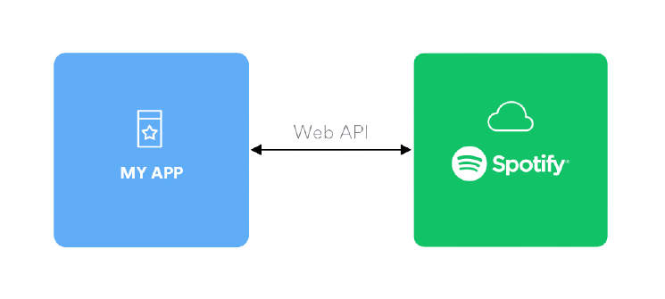
Apollo
Spotify API
Web API
With the help of Spotify API our application is able to fetch data from Spotify music catalog and manage user's playlist and saved music. We are defining the scopes that let us specify exactly what type of data we want to access and what access permissions the user is asked to grant.
The Audios Co.
Back
09/26
Next

Slide 10

Apollo
Youtube API
With the help of Youtube API our application is able to retrieve feeds related to videos, users and playlists. We are also using functionalities like manipulating the feeds, creating new playlist, addding videos to the playlist.
The Audios Co.
Back
10/26
Next

Slide 11
Apollo
FRONT END
Side Menu
User Playlist
Header
Main Header
Main View
Footer
-browse action
-song action
-album action
-artist action
-UI action
-playlist action
-UI action
-user detail
-Track search
-song action
-browse action
-song action
-UI action
-Song List
-Album List
-Artist List
-Browse View
-Song Control
-song action
-Volume Control
-sound action
Back
11/26
Next

Slide 12
Apollo
BACK END
Models
Routes
Controllers
-user.js
-user.js
-auth.js
-auth.js
-user.js
Back
12/26
Next

Slide 13

Apollo
Our Application
Detailed explanation of the implementation of the application.
Back
13/26
Next

Slide 14

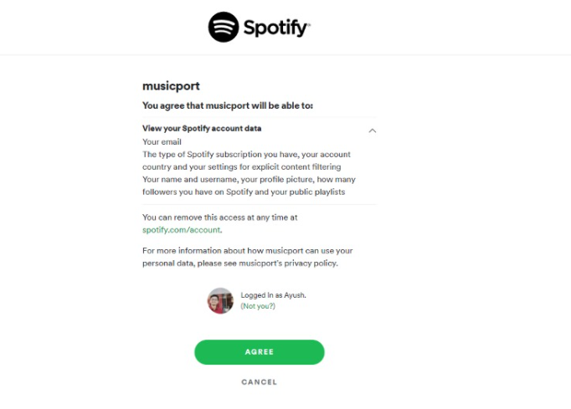
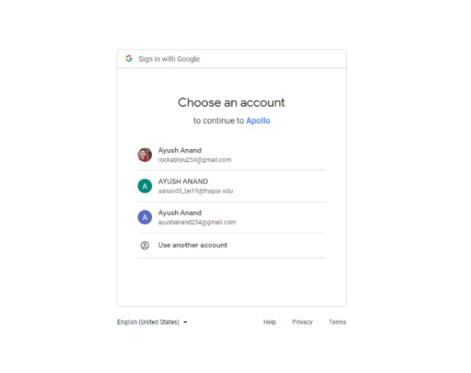
Authentication
Apollo
Back
14/26
Next

Slide 15
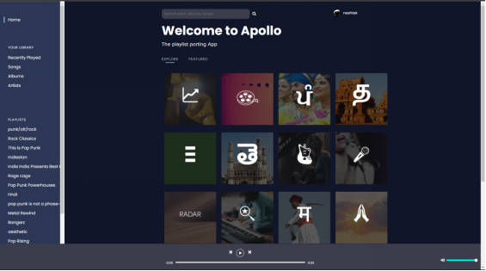
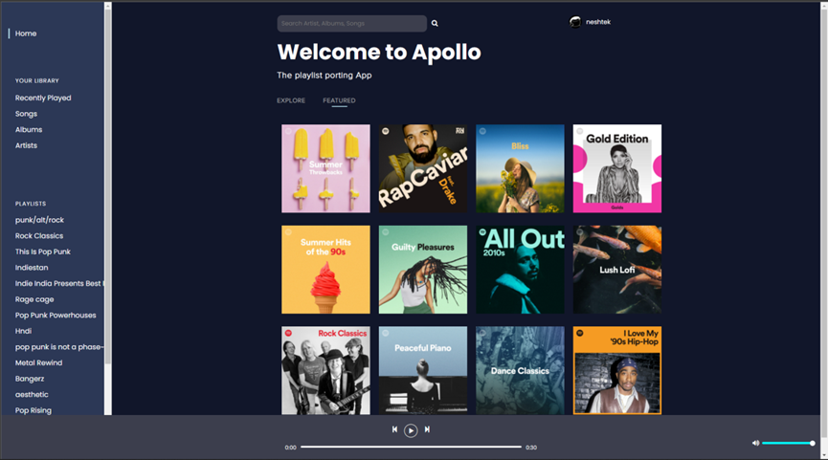
Home
Apollo
Back
15/26
Next

Slide 16
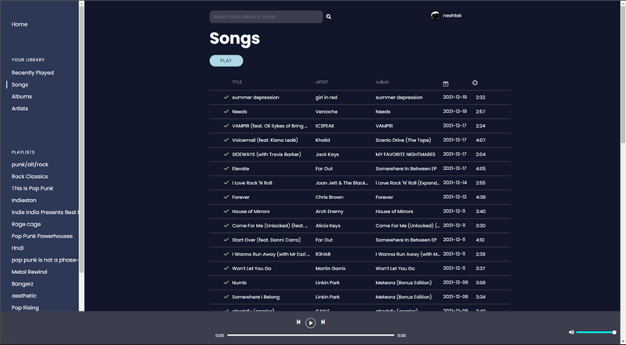
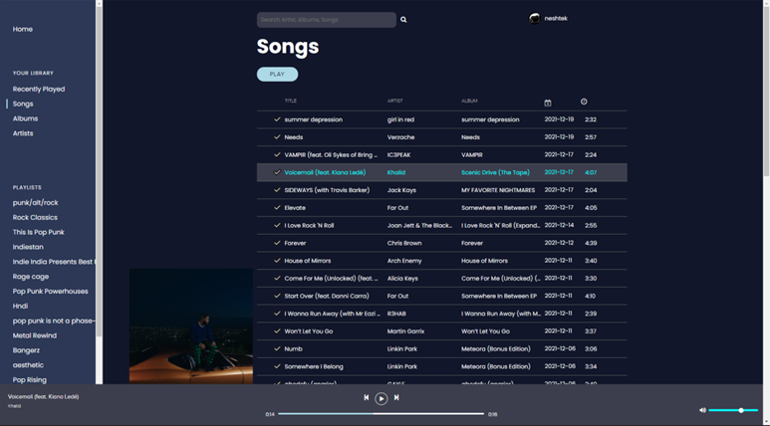
Songs
Apollo
Back
16/26
Next

Slide 17
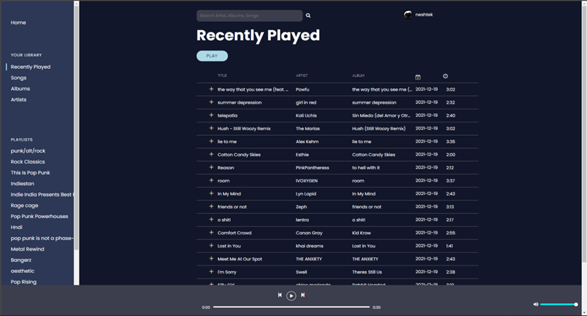
Recently Played
Apollo
Back
17/26
Next

Slide 18
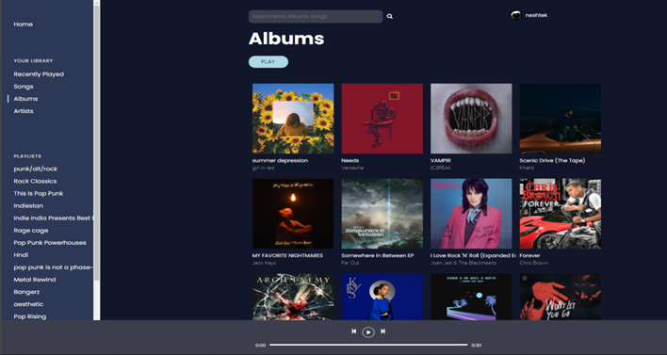
Albums
Apollo
Back
18/26
Next

Slide 19
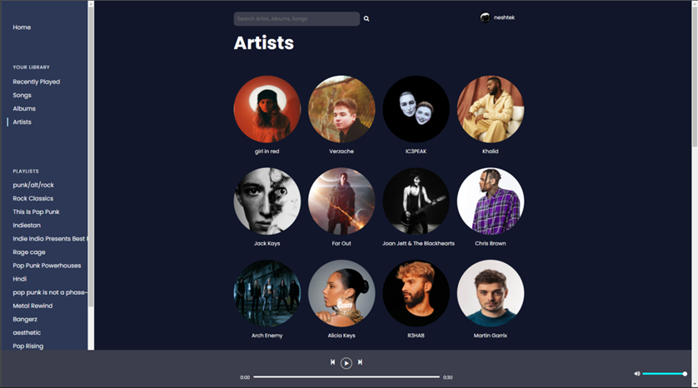
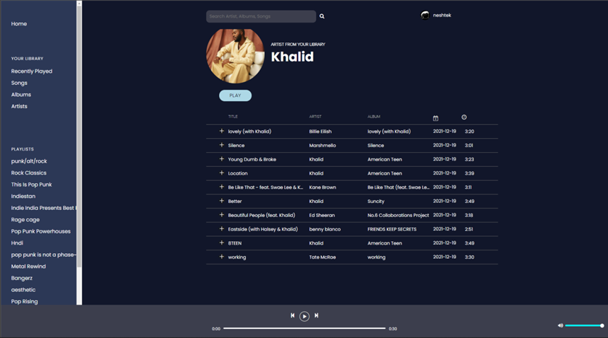
Artists
Apollo
Back
19/26
Next

Slide 20
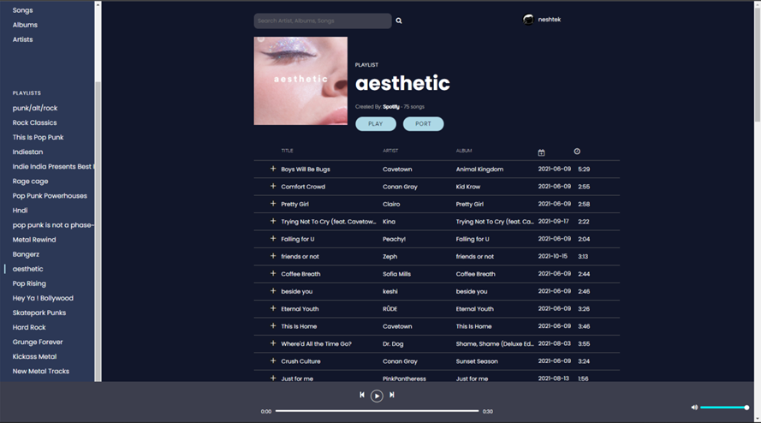
Playlist
Apollo
Back
20/26
Next

Slide 21
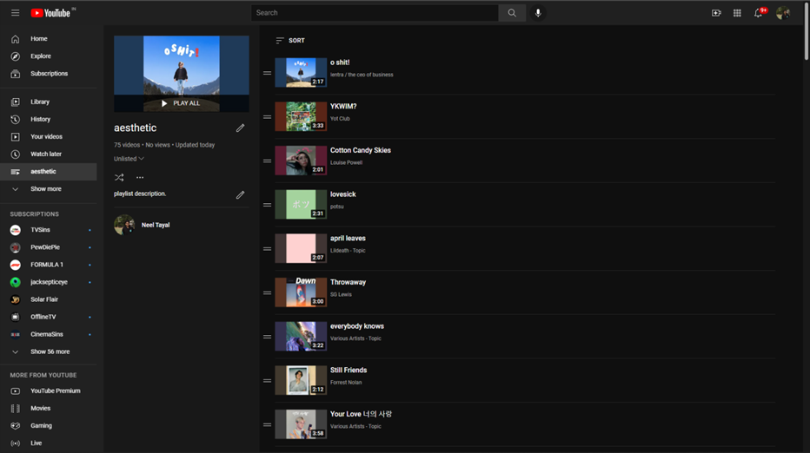
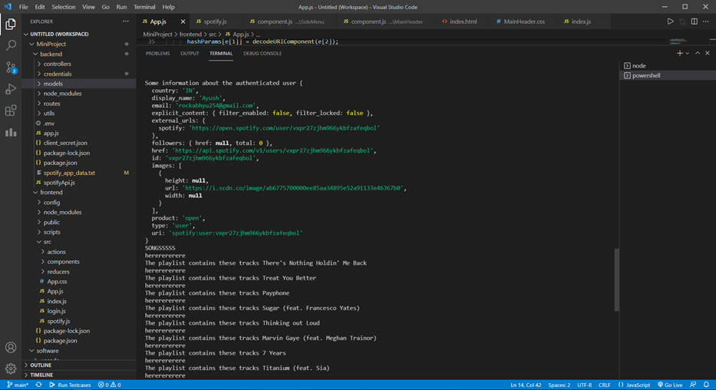
Porting
Apollo
Back
21/26
Next

Slide 22

Apollo
Challenges & Limitations
Explaining the errors we faced and the limitations of our application.
Back
22/26
Next

Slide 23
Apollo
Error Status 403: Forbidden
Error Status 400: Invalid Body Snippet
Challenges
Asynchronous Code Error
Spotify API Scope Error
Back
23/26
Next

Slide 24
Apollo
Limitations
Error Status 403: Forbidden
Stream Duration
Porting Multiple Playlists Together
YouTube Quota Expired: YouTube only allows up to 10,000 requests per day per user for free. In order to extend this Quota, the developer is required to pay extra charges.
Music streaming is limited to 30s per song as per Spotify’s API.
Multiple Playlists cannot be ported to YouTube at the same time due to the fact that no particular request can be tied to the list of songs, and hence a mismatch occurs.
Back
24/26
Next

Slide 25

Apollo
Questions?
Back
25/26
Next

Slide 26
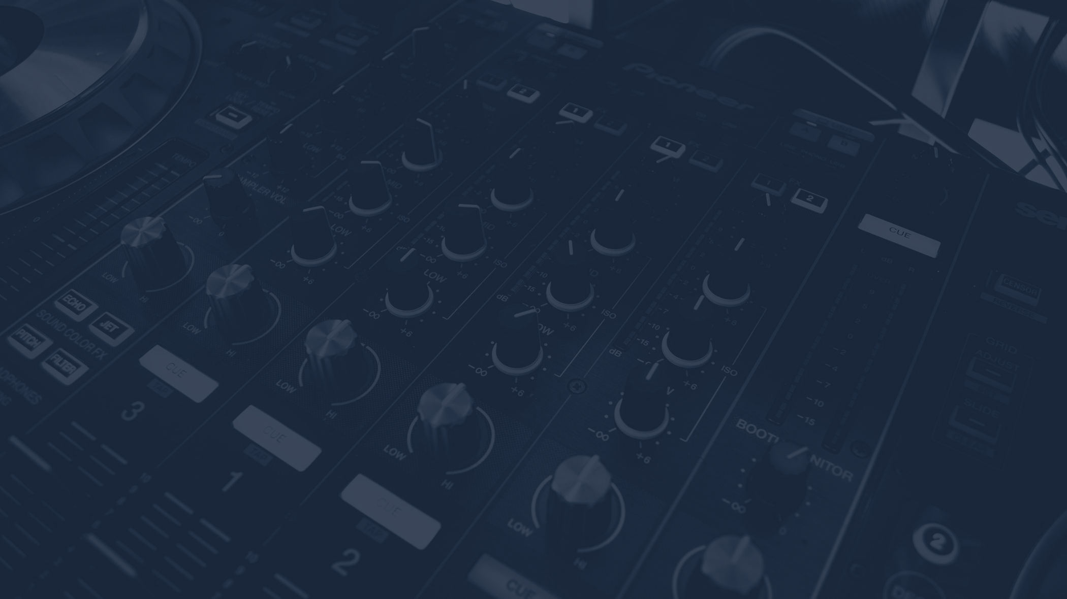
Thank You!
Back
26/26

